Slide 1


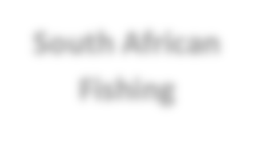







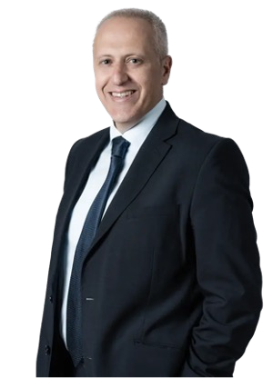












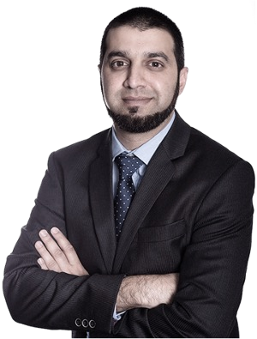
SEA HARVEST: COMPANY PROFILE
History and Background
Strategy and Operating Segments
Company Background Founded in 1964, Sea Harvest is a prominent vertically integrated business involved in seafood, aquaculture, agri-processing, and branded fast-moving consumer goods (FMCG), with a global presence. The company primarily engages in the harvesting of wild-caught seafood from the coasts of South Africa, Mozambique, and Australia, processing these catches into a diverse range of chilled and frozen premium seafood products. These products are marketed both locally and internationally, catering to a demand-driven seafood market.
Strategic Focus Sea Harvest Group has developed its strategy around six key pillars, which are divided into two main categories: organic growth and acquisitive growth. The organic growth strategy emphasizes increasing volume and enhancing profit margins, while the acquisitive growth strategy aims to expand into South African seafood, aquaculture, international seafood markets, and the broader South African food sector.
Sea Harvest Group
South African
Fishing
Australian Fishing
Aquaculture
Cape Harvest
Species / Products:
Hake
Horse Mackerel
Prawn
Anchovy
Pilchard
Species / Products:
Prawn
Spanish Mackerel
Scallop
Crab
Species / Products:
Abalone
Oysters
Species / Products:
Cheese
Butter
Powders
Convenience Foods
Shareholding Structure and Key Leadership
Shareholding as at 31 Dec 2021
FELIX RATHEB
Sea Harvest Group CEO
Appointed: 2009 Qualification: B.Sc. (Hons.) (Elec. Eng.), MBA
46.2%
31.2%
58% 97%
12% 4%
2% -9%
28% 8%
FY2021 ('000) | Total | SA Fishing | Australian Fishing | Aquaculture | Cape Harvest
Revenue | 4 616 | 2 664 | 554 | 92 | 1 306
Operating Profit | 691 | 672 | 31 | -64 | 52
EBITDA | 916 | 831 | 57 | -58 | 86
MUHAMMAD BREY
Sea Harvest Group CFO
Appointed: 2016
Qualification: CA(SA)
8.8%
7.2%
6.6%
Newshelf Public Newshelf Visio Capital Other (< 5%) 1411 Pty Ltd Investment 1169 Pty Ltd Management
Corporation
Revenue contribution (FY21):
Operating profit contribution (FY21):
Source: Company website and annual reports
1

